Slide 1




E-Music COMPOSER
SUBMITTED BY
DARSANA DASAN
S6 MCA
MCT19MCA002

Slide 2


INTRODUCTION
Composing music is a very interesting challenge that tests the composer’s creative capacity, whether it a human or a computer.
Although there have been many arguments on the matter, almost all of music is some regurgitation or alteration of a sonic idea created before.
Thus, with enough data and the correct algorithm, machine learning should be able to make music that would sound human.
Our accuracy will be measured by taking 4 predicted noted and comparing those to ground truths.
this project provides an investigation into creating 6 an effect model for the music industry.

Slide 3
1. GENERATING MELODY WITH NEURAL NETWORK
2. BUILD AND TRAIN WITH LSTM NETWORK
4. PREPROCESSING
3. BASIC MUSIC THEORY
CONTENTS

Slide 4

TOOLS AND LIBRARIES
TENSORFLOW/KERAS
MUSIC21
MUSE SCORE

Slide 5
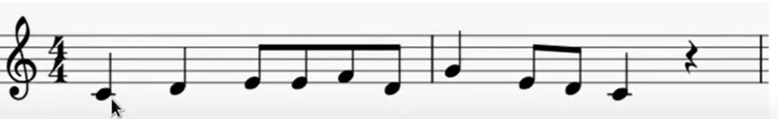
BASIC CONCEPTS
MELODY
SEQUENCE OF NOTES AND RESTS.

Slide 6
BASIC CONCEPTS(CONT….)
MELODY GENERATION PROBLEM
Treat melody as a time series.
Time-series prediction problem
Vocabulary of notes

Slide 7
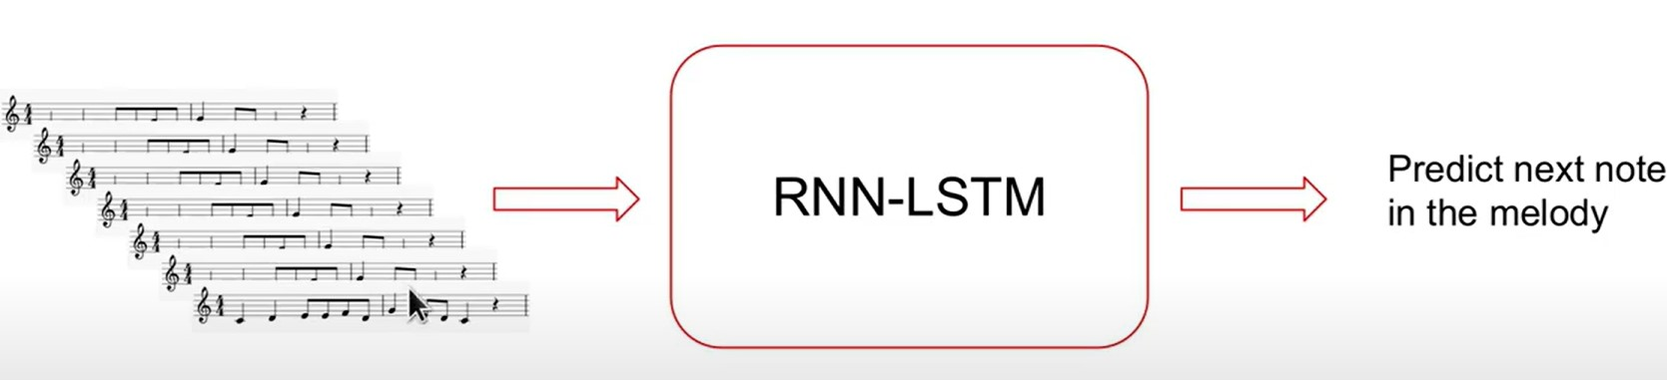
BASIC CONCEPTS(CONT….)
THE MELODY GENERATOR(TRAINING)

Slide 8
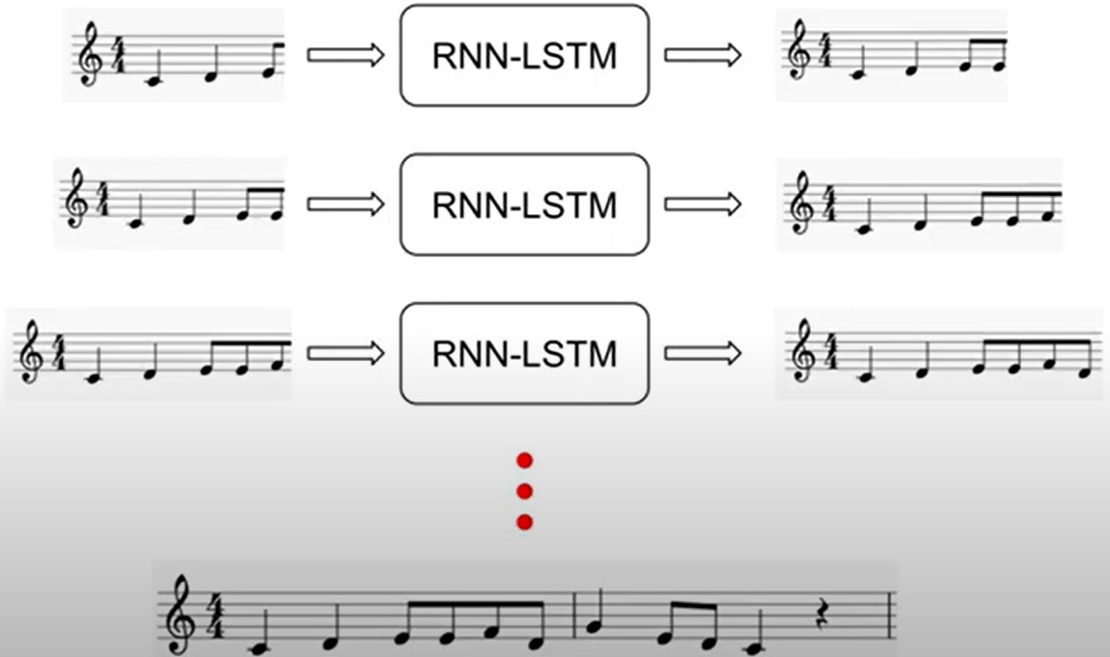

BASIC CONCEPTS(CONT….)
HOW WE GENERATE MUSIC

Slide 9
BASIC CONCEPTS(CONT….)
WHY DO WE USE AN RNN-LSTM
MELODIES HAVE LONG-TERM STRUTURAL PATTERNS
LSTM CAPTURE LONG TERM DEPENDENCIES

Slide 10

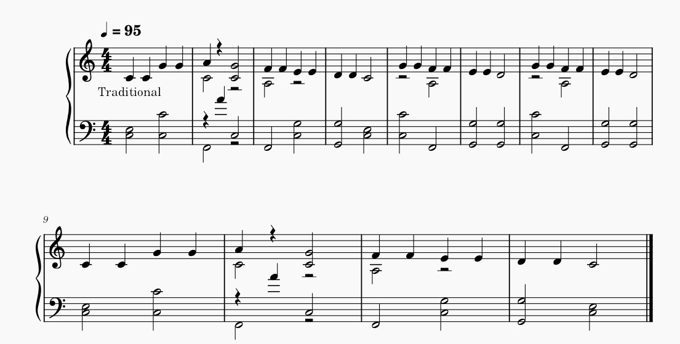
BASIC CONCEPTS(CONT….)
EXAMPLE

Slide 11


MUSIC THEORY
KEY
MELODY
PITCH
DURATION
BEAT
TIME SIGNATURE

Slide 12



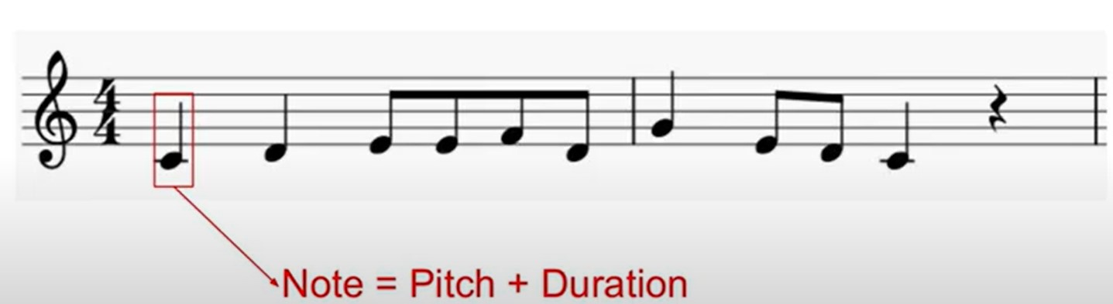
MUSIC THEORY (CONT….)
MELODY
SEQUENCE OF NOTES AND RESTS.

Slide 13
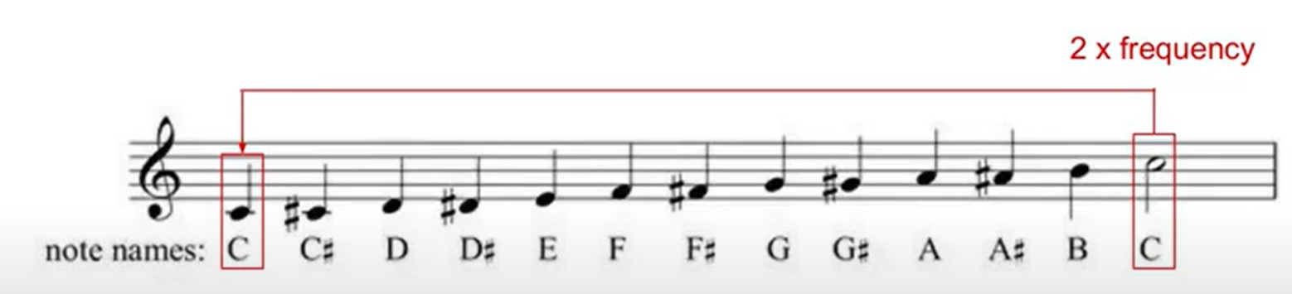
MUSIC THEORY (CONT….)
PITCH
INDICATESHOW HIGH/LOW A NOTE IS
NOTE NAME+OCTAVE
EG: C3,D4,A1

Slide 14
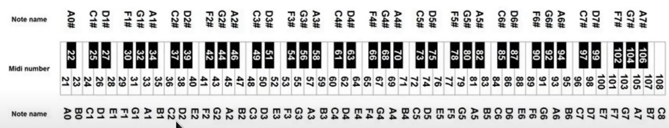
MUSIC THEORY (CONT….)
MIDI NOTE NOTATION
MIDI IS A PROTOCOL TO PLAY, EDIT AND RECORD.
MAP NOTE NAMES TO NUMBERS
C4 = 60

Slide 15
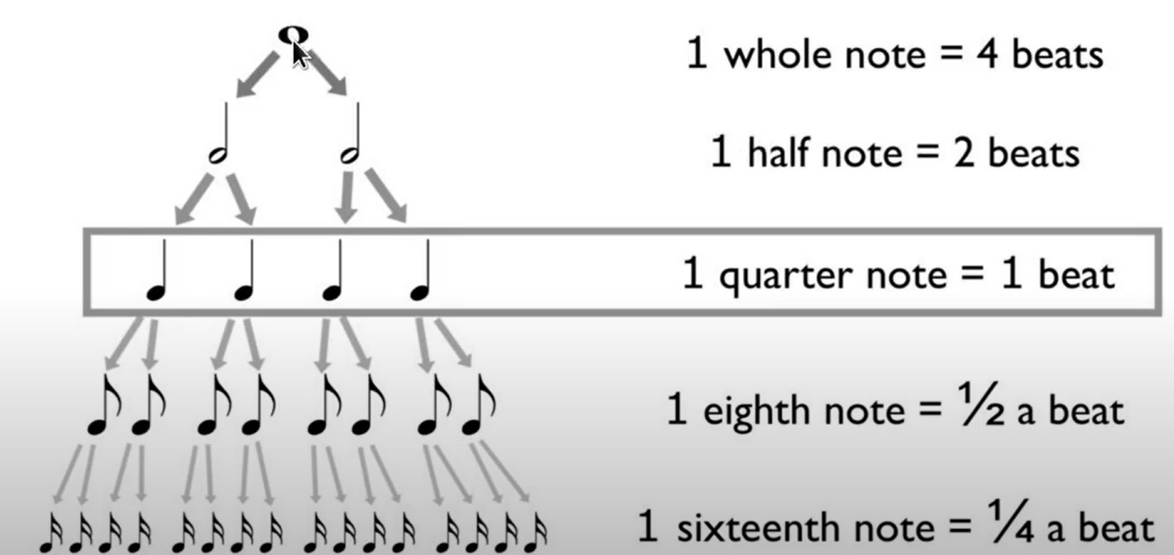
MUSIC THEORY (CONT….)
DURATION
NOTE VALUE

Slide 16
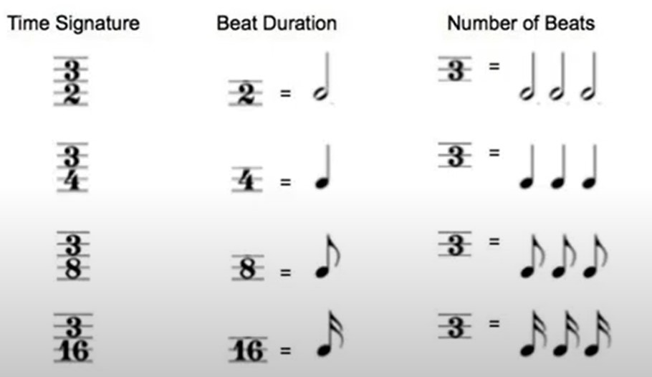
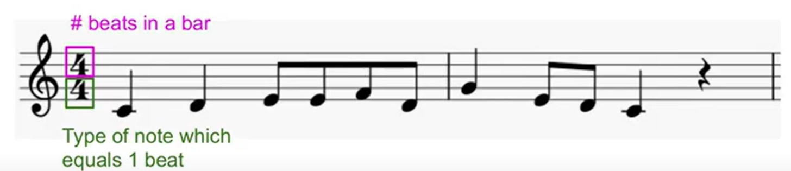
MUSIC THEORY (CONT….)
BEAT
UNIT OF TIME IN MUSIC.
CORRESPONDCE TO THE POLE OF THE MUSIC.
TIME SIGNATURE

Slide 17
MUSIC THEORY (CONT….)
KEY
GROUP OF PITCHES (I.E,SCALE) THAT FORMS THE CENTER OF PIECE.
TONIC + MODE
EG: C MAJ,A MIN

Slide 18
PRE-PROCESSING
TRANSPOSITION :
MOVING COLLECTION NOTES UP/DOWN BY A GIVEN INTERVAL.
CHANGE KEY
MUSICAL CONTENTS REMAINS THE SAME

Slide 19
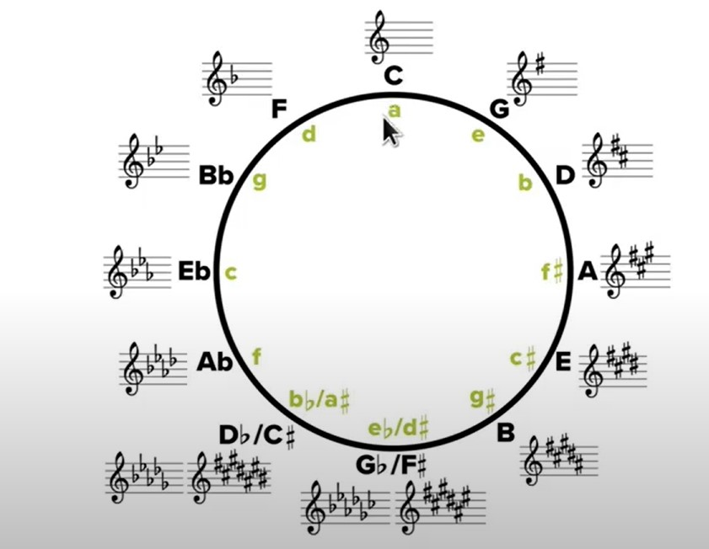
PRE-PROCESSING (CONT….)
12 NOTES * MODES = 24 KEYS

Slide 20
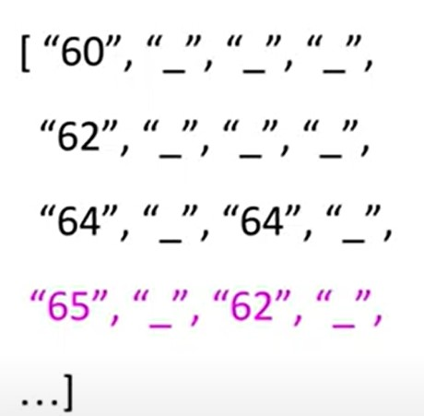
PRE-PROCESSING (CONT….)
TIME-SERIES REPRESENTATION
TIME SERIES
SAMPLE MELODY AT EACH 16TH NOTE
EACH STEP = 16 NOTE
LOG MIDI NOTE
USE “_” SYMBOL FOR HELD NOTES
USE “ ” SYMBOL FOR REST
WHEN ENCODING

Slide 21
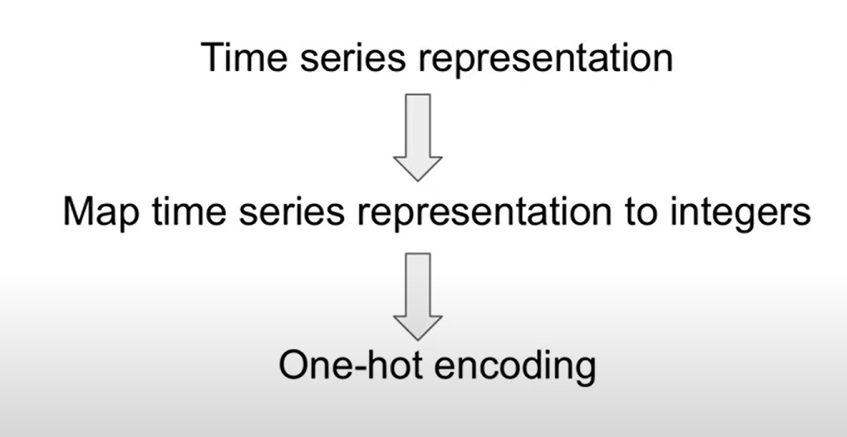
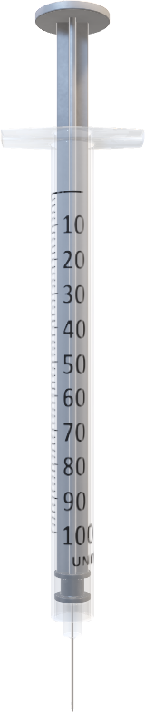
PRE-PROCESSING (CONT….)
PREPARING MELODIES
FOR LSTM
INGESTION

Slide 22
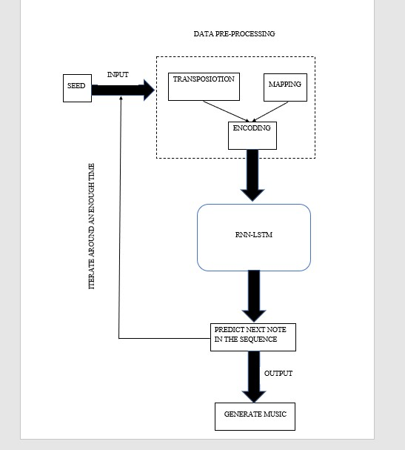
PROCESS FLOW DIAGRAM
Sample output

Slide 23
CONCLUSION
a short discussion about what would the term “intelligent” denotes when speaking about automatic music composition .
The intelligent part of the compositional methodologies would be composing music destructively, without the imposition of restrictions or targets, forming the category of unsupervised intelligent composition methods.
The imposition of compositional restrictions with the introduction of target features that derive from stylistic directions forms the category of supervised intelligent composition.
The system is very light, platform independent and portable in nature and can be easily deployed on any user system or can be utilized as a web application thus making it available on a network.

Slide 24

Thank you

